Slide 1
Orthopedic Surgery Rotation at OHRH
Adam Barnard,PA-C

Slide 2
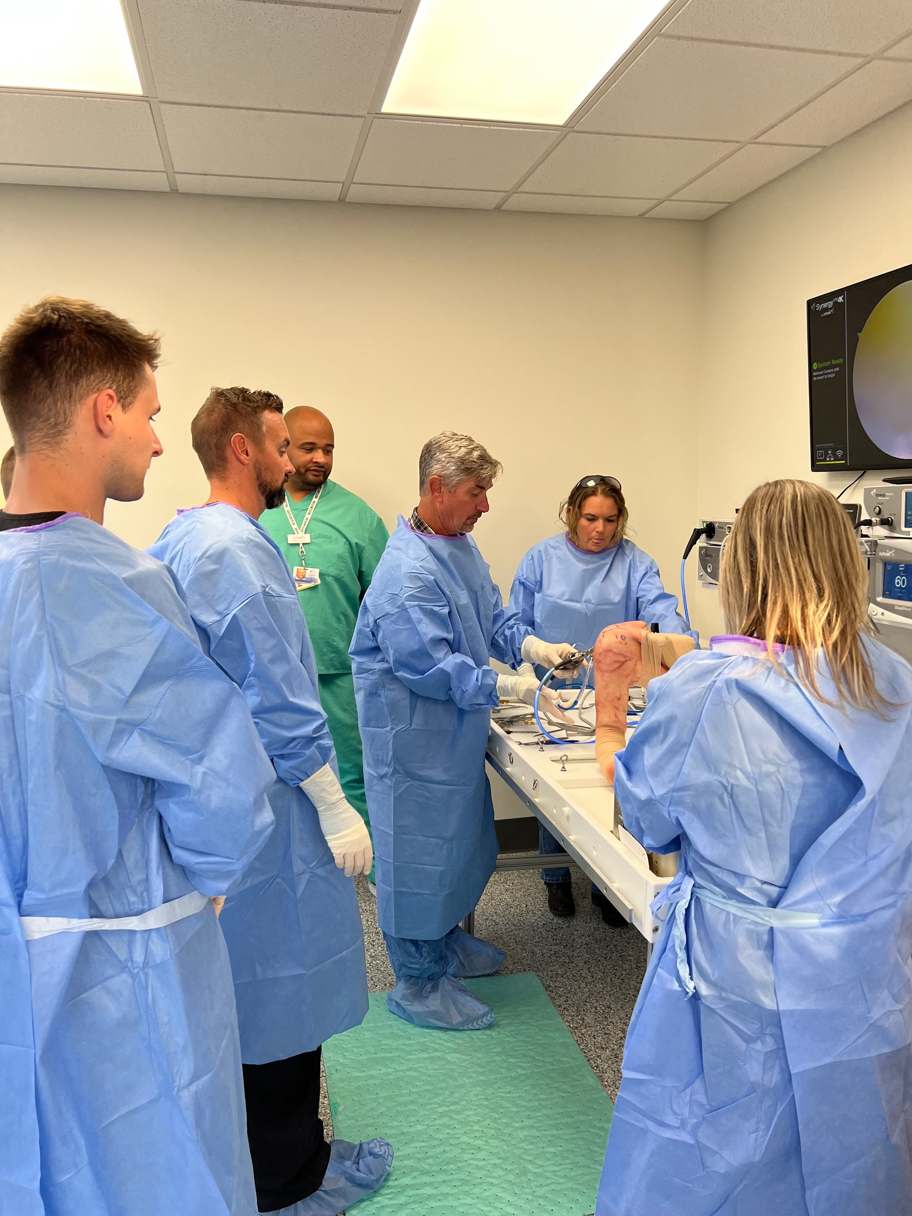
THANK YOU ARTHREX
First things first…THANK YOU to Demarco Monroe and the Arthrex team!!!

Slide 3
Personal Bio
Undergrad at UK 2001-2005
PA school at UNTHSC 2008-2011
Employed by Owensboro Health Orthopedics and Sports Medicine August 2015-current
Our Surgeons
Reid Wilson, MD
Anthony McBride, MD
Scott Farner, MD
Our Advanced Practice Providers
Adam Barnard, PA-C
Ryan Coyne, PA-C
Lauren Mahoney, PA-C
Vinny Gizzi, PA-C
Katie Bowlds, APRN
UEPA program and Owensboro Health Orthopedics and Sports Medicine
8-10 rotation slots/yr
Rotate with PAs
Several satellite clinics
Henderson, Madisonville, Hartford, Tell City
Also have Non-operative Sports Medicine physician Dr.Stolz and University of Louisville Family Medicine Residency
Podiatry

Slide 4
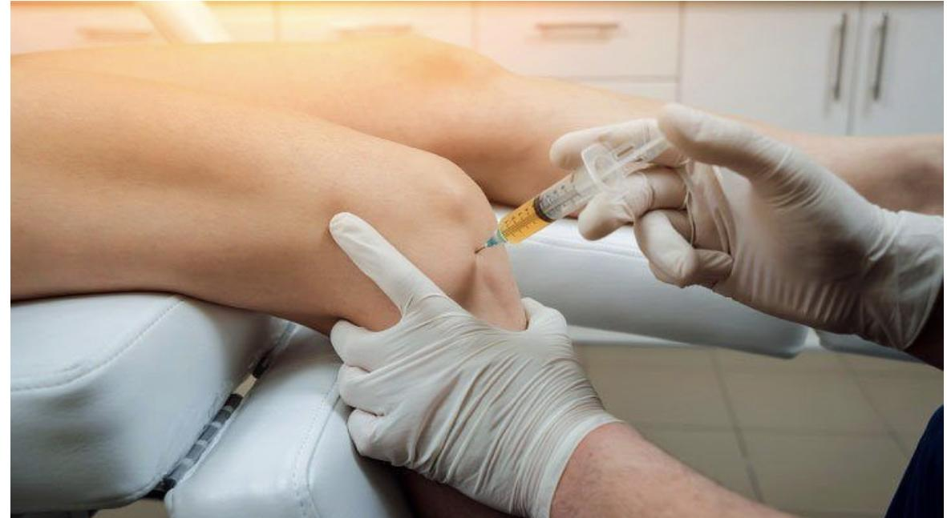
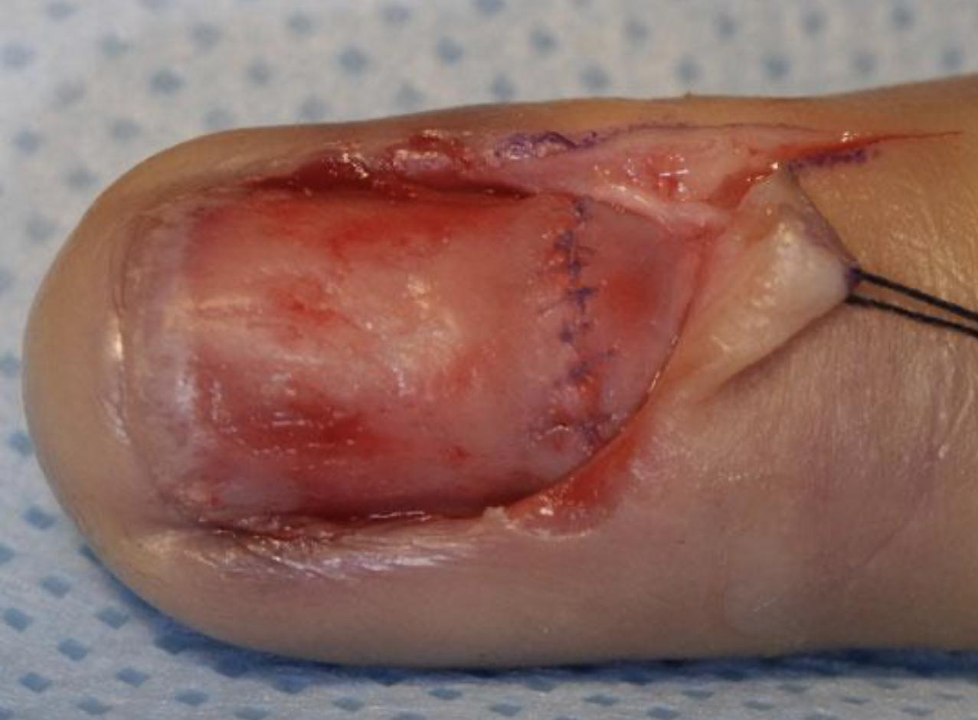
Clinic Duties of Ortho PA’s
Walk-in Clinic
Inpatient Consults
Emergency Department Consults
Radiology Interpretation
Injections/Aspirations
Discharge/Admission Planning
Peer-to-Peer Reviews
Minor Surgical Procedures Under Local Anesthesia

Slide 5
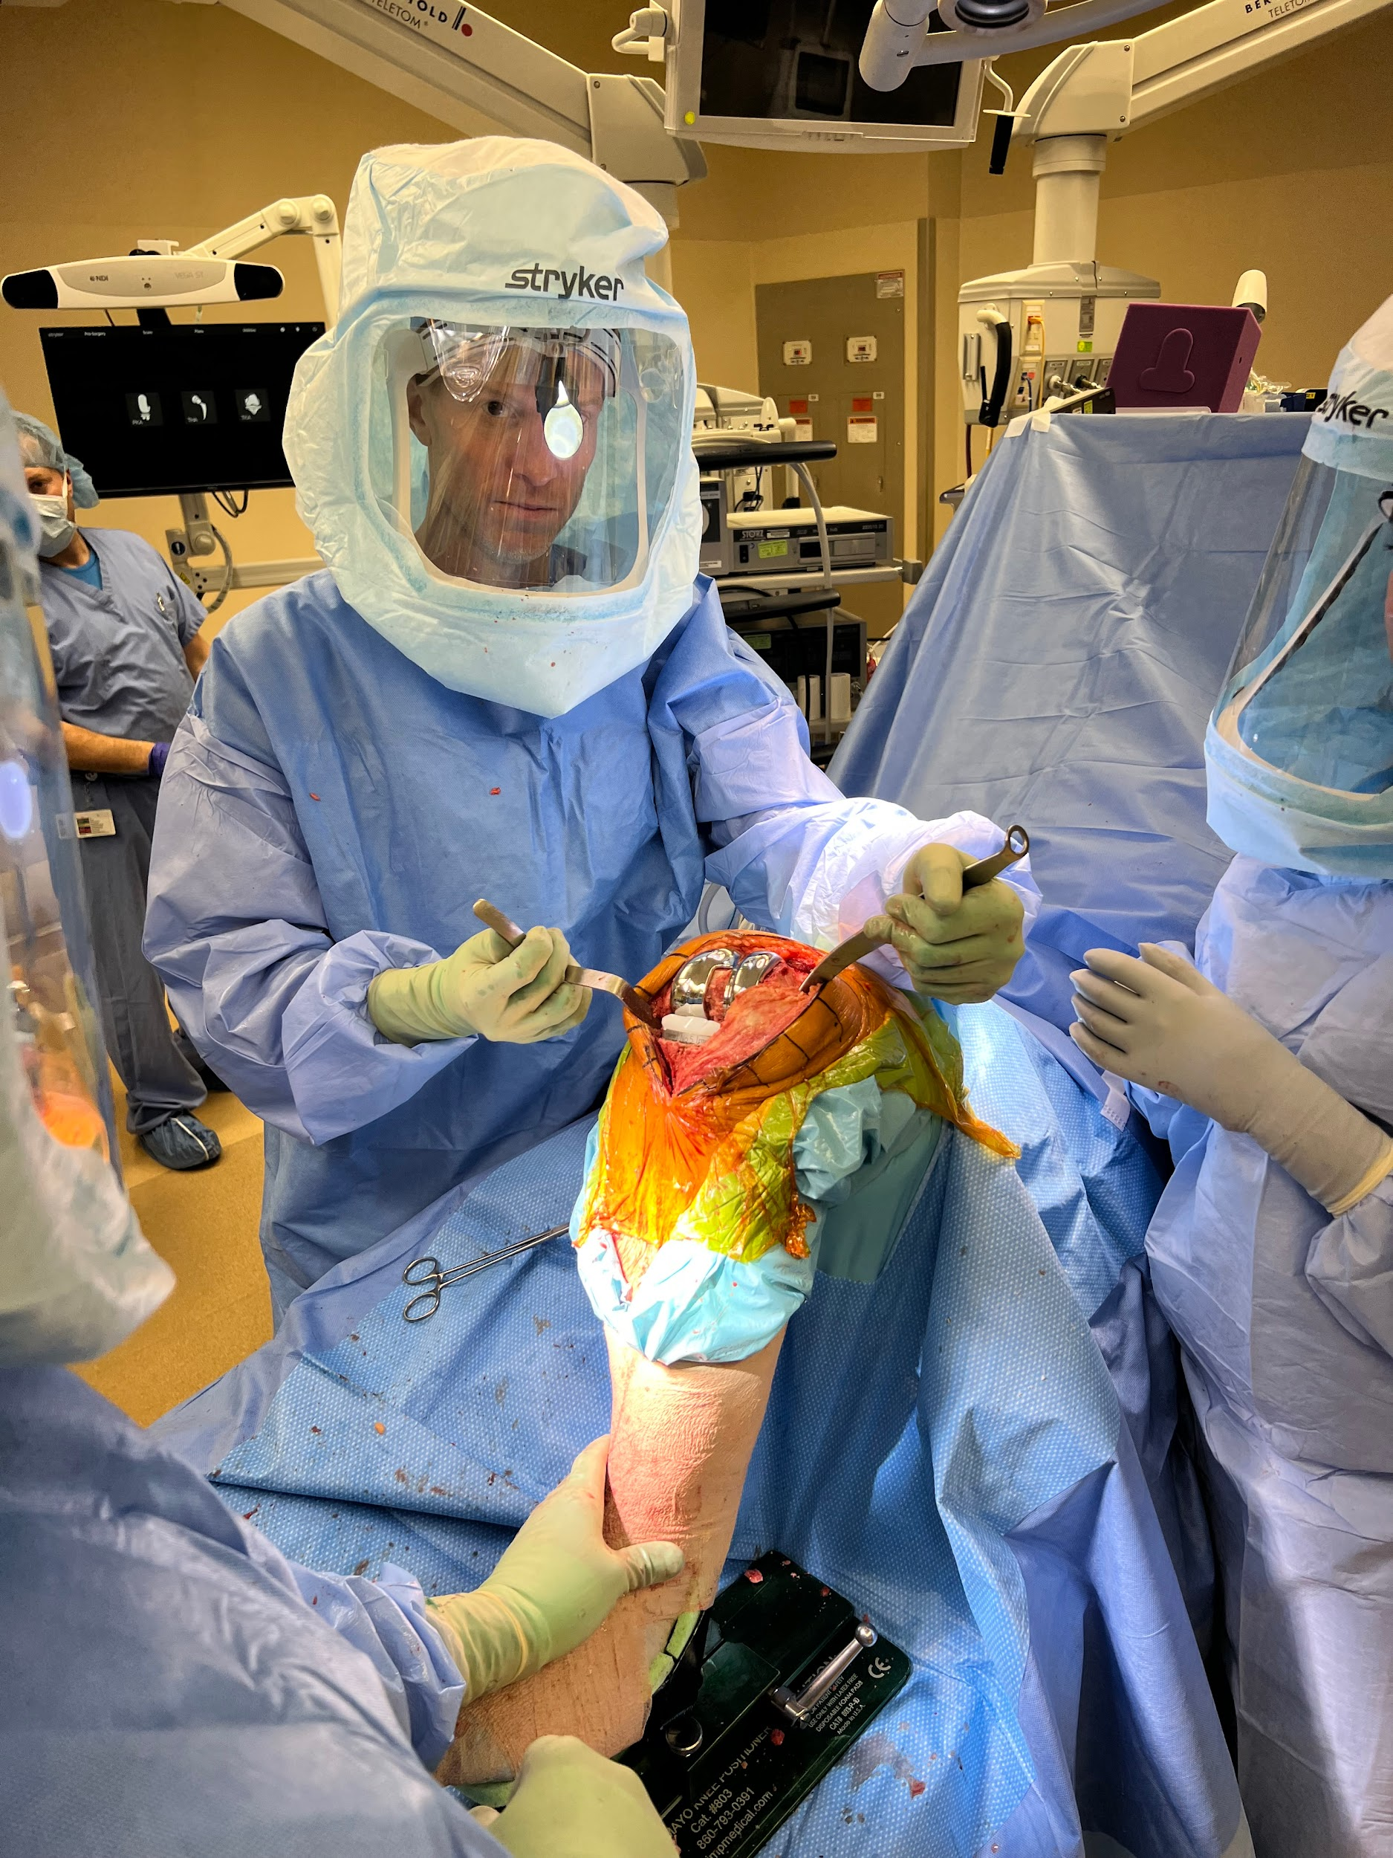
Operating Room Duties of Ortho PA’s
All aspects of perioperative care including Pre-op/Post-op orders
H&P’s
Patient positioning/preparation on OR table
Closing surgical incisions
Digital blocks
Percutaneous pinning
Bony resections and soft tissue removal with sharp dissection and electrocautery

Slide 6
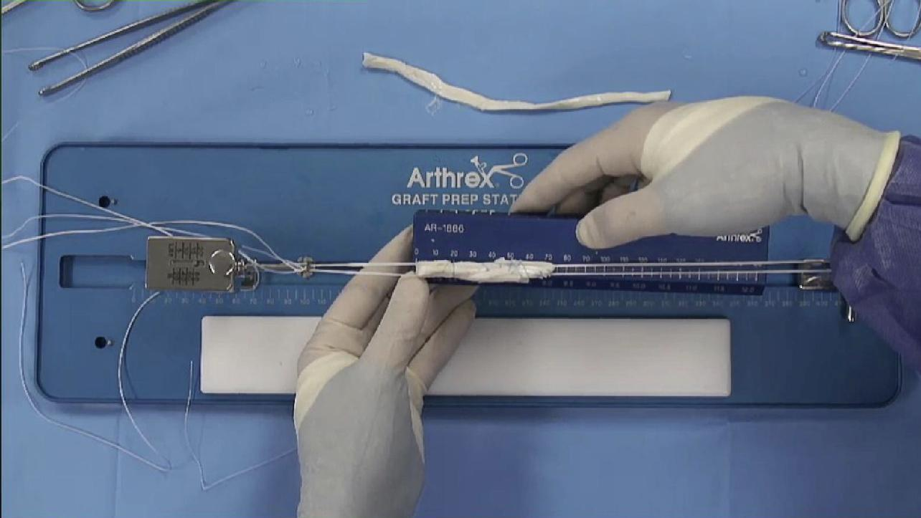
Operating Room Duties of Ortho PA’s
Autograft/Allograft tissue preparation
Arthroscopy and Endoscopy setup/use
Suturing
Application of splints/dressings/casts
Utilize Radiology Equipment
Closed reductions
Whatever else your surgeon asks/trusts you to do!

Slide 7
Basics Before You Begin Ortho Rotation
LEARN TO TIE KNOTS!
Practice using large suture material, shoestrings, paracord,etc to better visualize movements that create sliding vs square knots. When you’re actually in surgery you will panic and forget everything…having muscle memory already established will help you stay focused.
Master tying with instruments before moving on to hand ties.
One handed tying should not be attempted unless you can demonstrate proficiency with two-hand ties first.
We double glove in Orthopedics, generally using ½ size smaller outer glove. Practice hand ties double gloved.
Approximate don’t strangulate!!! Decreased tissue perfusion = necrosis = increased infection risk, dehiscence, cosmetically un-appealing scars
Knots to know:
Master the most common ones first- Simple interrupted, Vertical and Horizontal Mattress, Deep dermal, Running Subcuticular, Running locked
More advanced: Trauma/Pulley(Far-near-near-far), Allgower-Donati, Krakow, Whipstitch, Kessler, Tsuge

Slide 8
Suturing
Whole books are written on suture materials and techniques! It takes years to master.
DON’T PANIC!!

Slide 9
Suturing
Sutures are “numbered” relative to diameter. Thicker sutures are sizes #0 through #10(with #10 being thickest). Thinner sutures…think “below zero” are numbered 1-0 through 12-0, with 12-0 being the smallest and lowest tensile strength.
Needle tip geometry: taper, cutting, reverse cutting, blunt tip, side cutting, straight.
Absorbable vs Non-absorbable, Synthetic vs Natural, Monofilament vs Multifilament(AKA Braided), Barbed, bidirectional, double armed, looped, swaged on, pop-off, slow vs rapid absorption.
Everyone does things differently based on training, supply/availability/cost, preference of tactile characteristics, patient allergies/intolerances, timeframe of healing/follow-up appointments, age of patient or skin characteristics, concern for cosmesis, bleeding/oozing, presence of infection (NO BRAIDED SUTURE!!), use of adhesive glues, and so on…
Learn how to tie simple interrupted throws of 3-0 and 4-0 nylon with instruments and deep dermal throws of 2-0 vicryl with two hands ties. You’ll be doing lots of these.

Slide 10
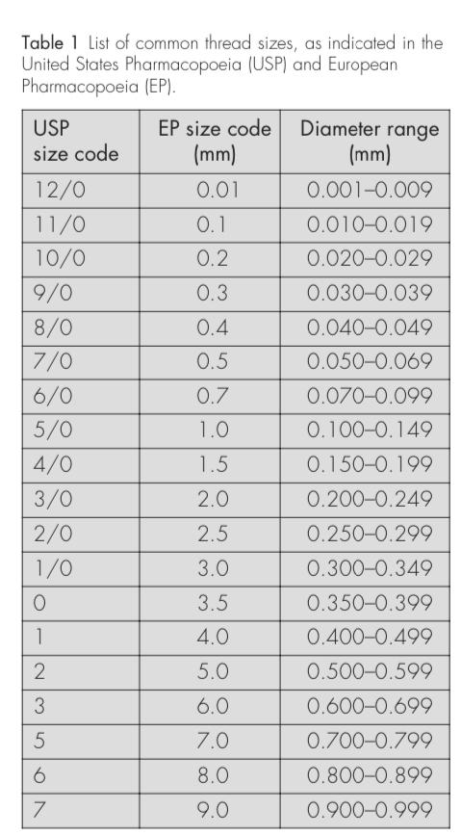
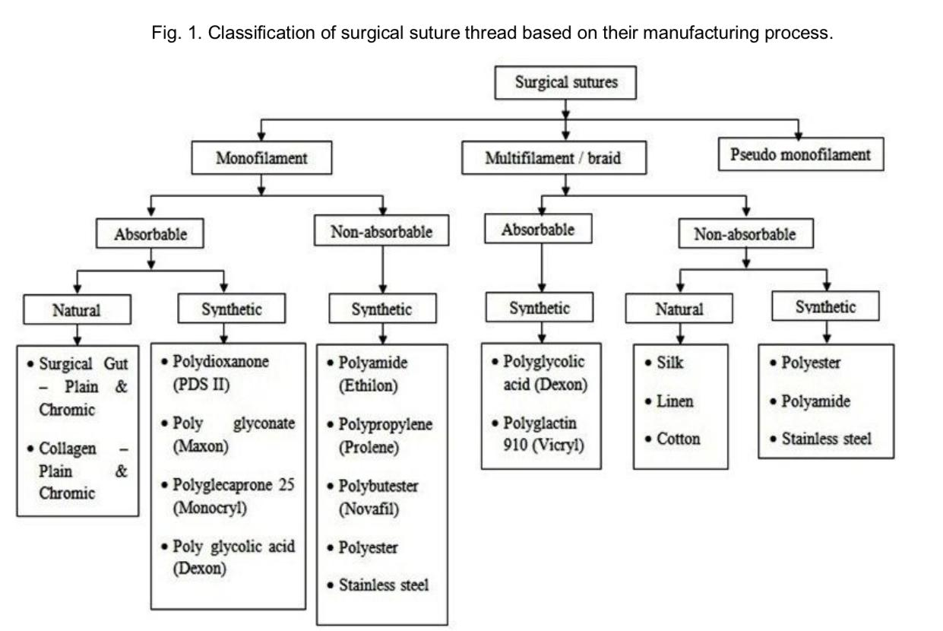
OK Now You Can Panic

Slide 11
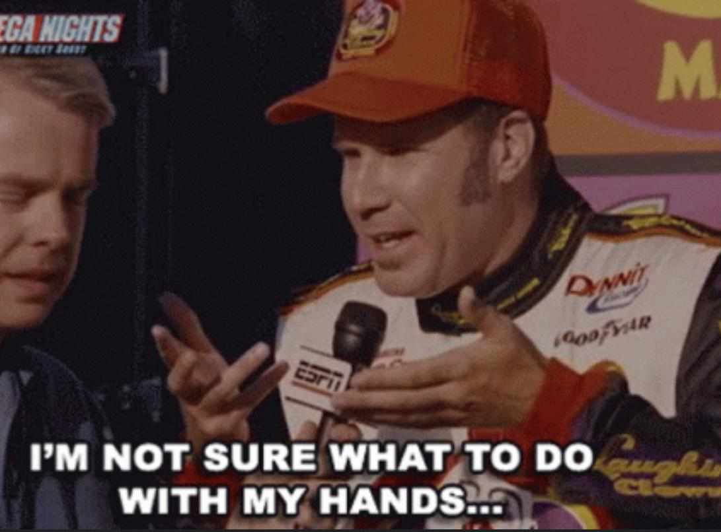
Maintaining Sterility and Avoiding Contamination Events
Practice Donning/Doffing hoods, gowns, and gloves.
Get close to the operating table after draping, surgery is a close-contact sport.
*ASK IF YOU’RE UNSURE*
Don’t reach down to catch falling instruments.
Back to back, front-to-front when passing by another sterile person.
Keep hands elevated up away from body after washing. You look silly, it’s OK.
Don’t adjust overhead lights unless asked to by the surgeon.
If you feel like passing out let someone know before you get beyond rescue, it’s NORMAL.
Never, ever, ever, EVER grab instruments off the scrub tech’s Mayo stand (They might “accidentally” stab you with something pointy)

Slide 12
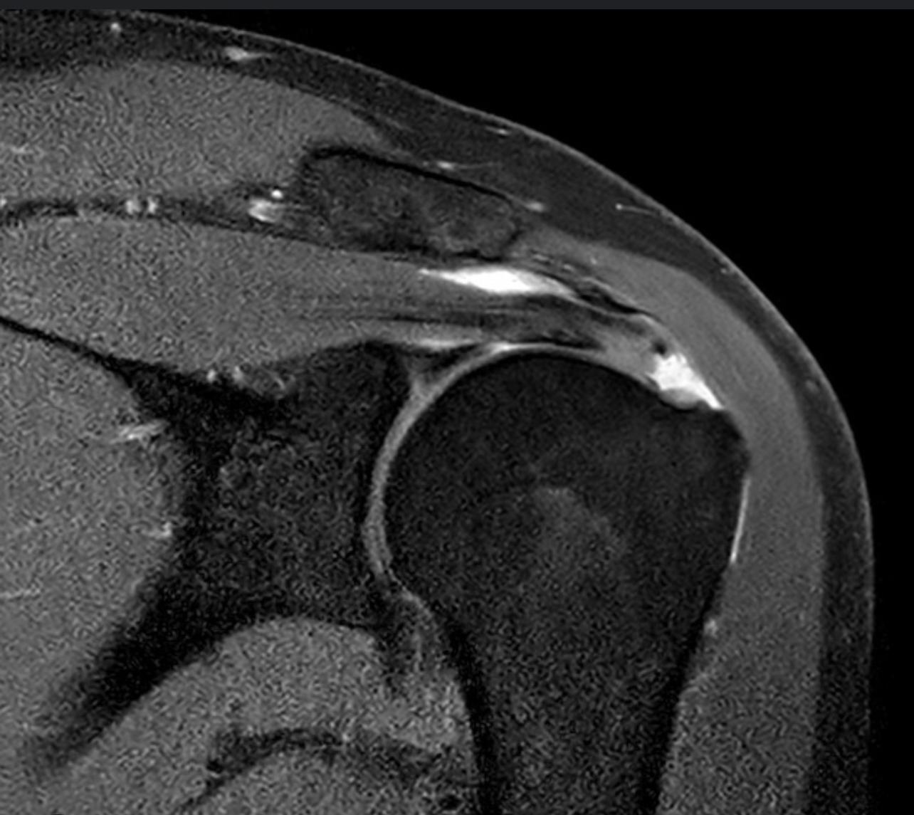
ORTHOPEDICS IS EASY IF YOU KNOW ANATOMY
Preview upcoming cases before the actual surgery. Watch videos on YouTube, Vumedi, Arthrex website, MedTronic Touch Surgery App, etc
Nerves aren’t yellow, Arteries aren’t red, and Vein’s aren’t blue in real humans
Study relevant anatomy based on the surgical approach, it will help you retain information and avoid iatrogenic injury…and we’re going to ask during cases!!!!
Think about nature of condition or mechanism of injury to affected body part being operated on
Study imaging modalities. X-ray, CT, MRI, etc

Slide 13
Now Let’s Have Some Fun
Ask questions, we’re here to help.
Watch out for slick floors and sharp objects.
Learning to use arthroscopy equipment is challenging and can often cause motion sickness, nausea,etc. Take a break if you need to.
Enjoy the snacks/drinks and please take time to thank the Arthrex crew for hosting us!!!
Orthopedic surgery isn’t for everyone and that’s OK!. If you are interested in doing a clinical rotation with our group please let the UEPA clinical director know.

