Slide 1
Pediatric Sports Injuries
Reid Wilson, MD
Adam Barnard, PA-C
Owensboro Health Orthopedics
Notes:
‹#›

Slide 2
Overview
Specific Upper and Lower Extremity Injuries
Low Back Pain in Athletes
Catastrophic Pediatric Sports Injuries
Miscellaneous Sports Issues

Slide 3
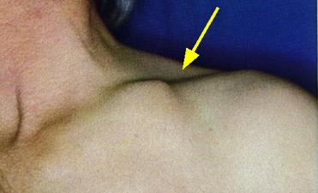
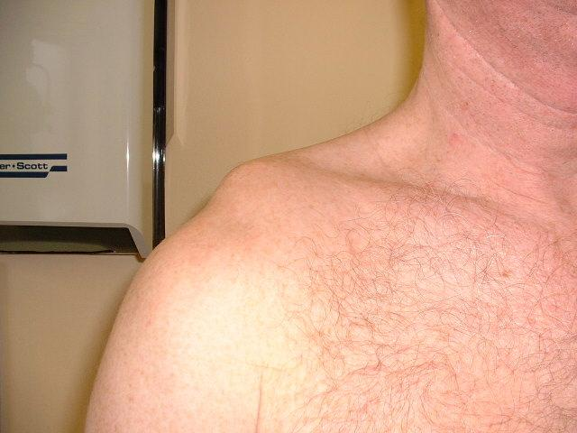
Upper Extremity Injuries
Clavicle Fractures
Diagnosis by X-Ray
Almost all are treated by sling and swathe
Watch for tenting of the skin
Acromioclavicular Sprain
Also called a shoulder separation
Dx by pain over AC joint and X-ray
Mainstay for treatment is symptomatic care

Slide 4
Stinger/Burner/Brachial Plexus Injuries
Burners and stingers (also known as "dead arm syndrome") refer to a transient brachial plexus neuropraxia that most commonly occurs due to a direct traumatic or tractional injury in contact sports
full cervical ROM
no tenderness
unilateral transient weakness in C5, C6 muscles (deltoid, biceps)
can have positive Spurling test
*OK to return to play if symptoms resolve (1-3min is typical)
Brachial Pleuxus Injury(BPI) typically result of high-speed injury (mostly motorcycles-83%)
Preganglionic (avulsion proximal to dorsal root ganglion, ie.CNS=poor prognosis)
Horner’s syndrome
Winged scapula
Flail arm
Postganglionic involves PNS, good prognosis

Slide 5
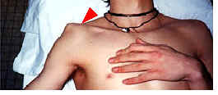
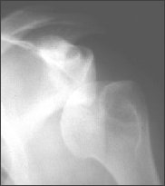
Upper Extremity Injuries
Glenohumeral joint dislocation
Massive pain and inability to move shoulder
May even complain of weakness in arm
Diagnosis by PE and X-ray
Treatment is by relocation
If dislocation occurs in those younger than 18 then there is a >80% chance of recurrent dislocation
May need to consider arthroscopic stabilization

Slide 6
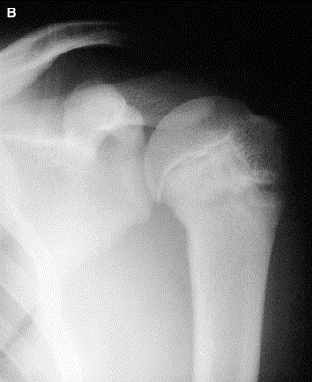
Little League shoulder
Overuse injury to the proximal humeral physis
Seen in throwers between 11-16
Diagnosis made by X-ray
Treatment is no throwing for 6 weeks, followed by X-ray evaluation showing nl physis

Slide 7
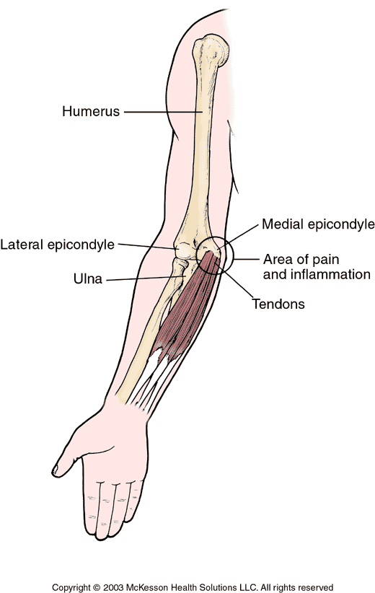
Medial Epicondylitis
Also known as Little league elbow
Diagnosis by pain in acceleration phase of throwing motion.
Age is usually 8-12 years old
Treatment is no throwing, ice and NSAIDS
Throwing may resume once pain has resolved

Slide 8
Supracondylar Elbow Fractures
Supracondylar Fractures are one of the most common traumatic fractures seen in children and most commonly occur in children 5-7 years of age from a fall on an outstretched hand.
Neuro exam
AIN neuropraxia-unable to flex the interphalangeal joint of the thumb and the distal interphalangeal joint of the index finger (can't make A-OK sign)
Radial N. neuropraxia-inability to extend wrist, MCP joints, thumb IP joint
PIP and DIP can still be extended via intrinsic function (ulnar n.)
Nearly all cases of neurapraxia following supracondylar humerus fractures resolve spontaneously
further diagnostic studies are not indicated in the acute setting
Gartland Classification
(may be extension or flexion type)
Type I
Nondisplaced
Beware of subtle medial comminution leading to cubitus varus which technically means it is not a Type I Fracture
Treated with cast immobilization x 3-4wks, with radiographs at 1 week
Type II
Displaced, in 1 plane
Posterior cortex and posterior periosteal hinge intact
Deformity is in the sagittal plane only
Typically treated with CRPP
Type III
Displaced, in 2 or 3 planes
Treated most commonly with CRPP or open reduction if needed
Type IV
Complete periosteal disruption with instability in flexion and extension
Diagnosed with examination under anesthesia during surgery
Treated most commonly with CRPP or open reduction if needed

Slide 9
Physiolysis of the Distal Radius
Most commonly seen in gymnasts
Described as insidious onset of pain at wrist. With some swelling noted
Radiographs show physis that is separating
Treatment is rest with restriction of weight bearing activities for 6-8 weeks with or without immobilization.

Slide 10
Distal Radius Fractures
Forearm fractures in total account for approximately 40% of all pediatric long bone fractures
peak incidence occurring from:
10-12 years of age in girls
12-14 years of age in boys
Don’t miss!!!!
Monteggia Fracture: ulnar shaft fracture with radiocapitellar dislocation
Galeazzi Fracture: radius fracture (typically distal 1/3) with associated DRUJ injury, often dislocation
Acceptable angulation for closed reduction:
Age < 10, less than 1cm of bayonetting, 15-20 degrees angulation(both bone), 30 degrees distal radius/ulna. 45 degrees malrotation
Age > 10, bayonetting unacceptable, 10 degrees angulation (both bone forearm), 20 degrees distal radius/ulna, 30 degrees malrotation

Slide 11
Lower Extremity Injuries
“Hip pointers”
Contusion to iliac crest
Treatment: RICE
Return to play when they have painless jog and jump
Apophyseal avulsion injuries
DDH/SCFE

Slide 12
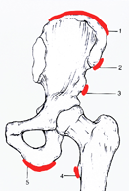
Avulsion Fractures
Know anatomy
External Oblique
Sartorius
Rectus
Psoas
Hamstrings

Slide 13
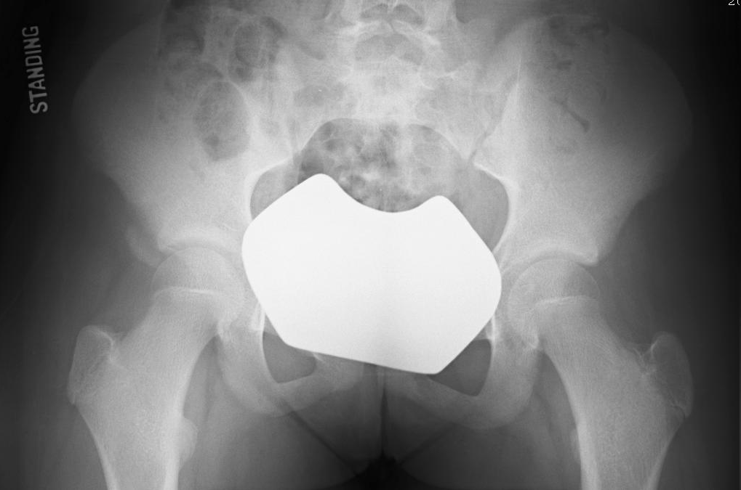
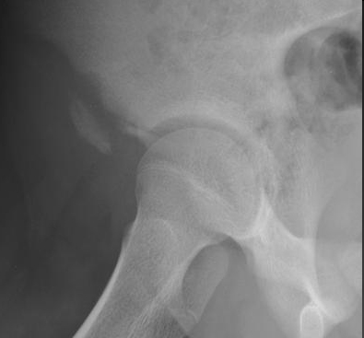
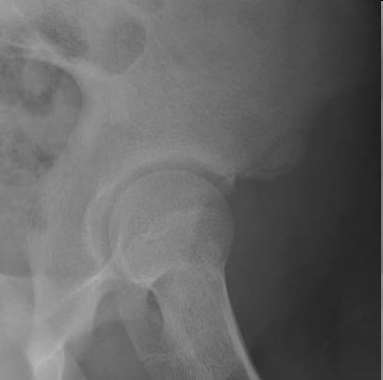

Slide 14
Developmental Dysplasia of Hip(DDH)
Developmental Dysplasia of the Hip is a disorder of abnormal development resulting in dysplasia, subluxation, and possible dislocation of the hip secondary to capsular laxity and mechanical instability.
Occurs at birth/childhood. Missed/untreated Dx
Limp, groin pain, LLD
More common on left side

Slide 15
Slipped Capital Femoral Epiphysis(SCFE)
Most common in obese males
Average age range is
12-13.4 for boys
11.2-12.2 for girls
Obligatory external rotation during passive flexion of hip (Drehmann sign)
Most commonly atraumatic
Pain in “hip/groin”
15-50% associated “knee pain”

Slide 16
Legg-Calve-Perthes(LCP)
Legg-Calve-Perthes Disease is an idiopathic avascular necrosis of the proximal femoral epiphysis in children
4-8 years is most common age of presentation
male to female ratio is 5:1
Insidious onset, painless limp, hip/thigh/knee pain

Slide 17
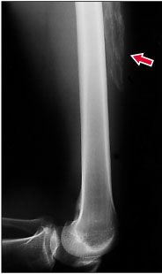
Strains
Muscle (usually quad, hamstring, or gastroc) usually crosses a joint
Pt can report pain or ripping followed by cramp
Ice and rest are key components
Persistent symptoms may represent myositis ossificans (calcification within the hematoma)
If present then avoid ultrasound and stretching

Slide 18
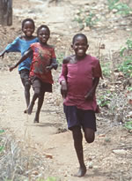
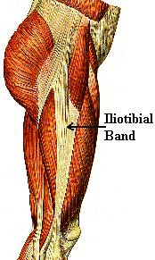
Iliotibial Band Syndrome
Seen in runners
The IT band rubs over the greater trochanter or the lateral condyle
Treatment is rest, and IT band stretching

Slide 19
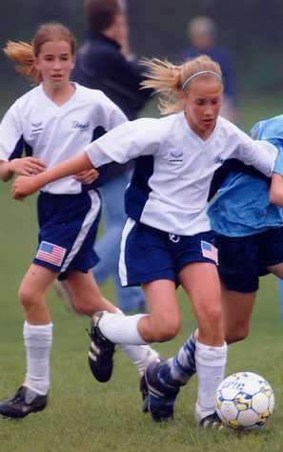
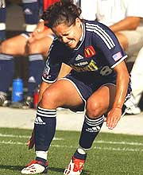
Knee Injuries
Anterior Cruciate Ligament Injuries
Describe a “pop” and immediate effusion with a tear
Inability to maintain play
Inability to walk
If sprained then may be able to continue

Slide 20
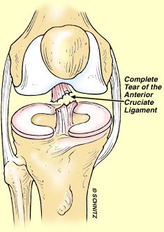
Knee Injuries
Anterior Cruciate Ligament Injuries
Physical exam demonstrates increased translation anteriorly of the tibia on the femur.
Diagnosis by plain film or MRI
Treatment for ACL tear is reconstruction
Sprains may be rehabbed

Slide 21
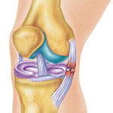
Knee injuries
Medial Collateral Injuries
Pain with valgus stress and tenderness over the ligament
Grade III tears show some gross instability
Treatment is with a hinged knee brace
Surgery is only rarely needed.
Watch for the MCL and ACL injury in combination

Slide 22
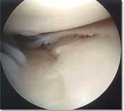
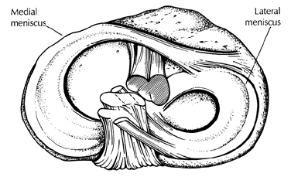
Meniscal Tears
Typically meniscal injuries are from a twisting injuries
Maybe associated with ACL tears.
Usually a history of locking and catching are given.
MRI is the test of choice for evaluation of menisci
Treatment is excision of the torn portion of the menisci via arthroscopy or repair if the ACL is being repaired at the same time.

Slide 23
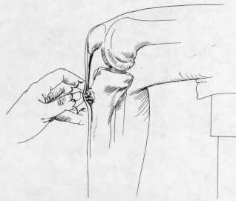
Osgood-Schlatter’s Disease
Seen in skeletally immature, preteen athletes
It is an apophysitis of the proximal tibial tubercle.
Pain with activity and at rest with direct pressure over tubercle
Treatment is RICE, knee pads, hamstring and quad stretches, and NSAIDS

Slide 24
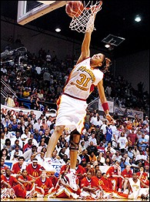
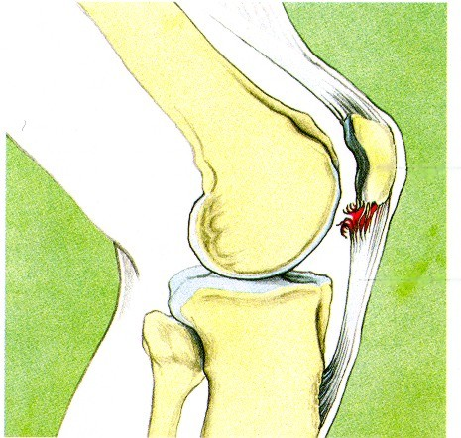
Patellar Tendonitis
Also called “Jumpers knee”
Pain at the inferior pole of the patella especially with jumping activity
Treatment is rest, stretching of the quad, NSAIDs, and a knee sleeve

Slide 25
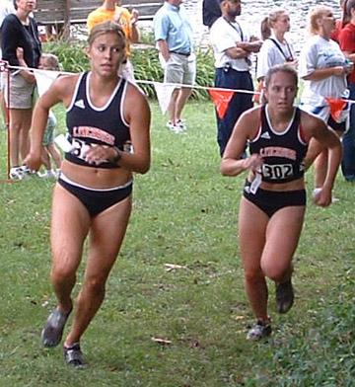
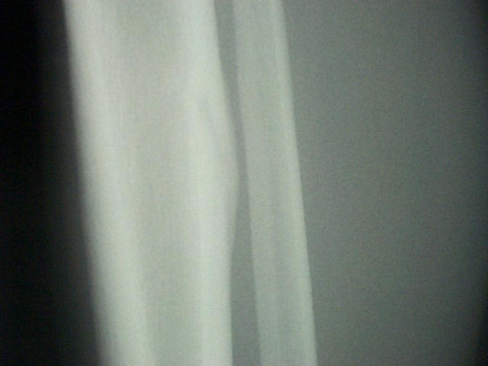
Tibial Stress Fracture
More common in runners, esp the amenorrheal females
Seeing the “dreaded black line” on radiographs means impeding complete fracture
Treatment with rest, and possibly fixation

Slide 26
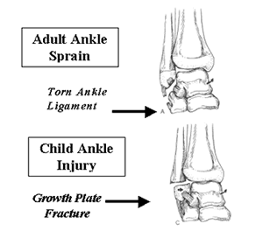
Ankle injuries
Very common injuries
Important to distinguish between ankle sprains and fractures (especially salter/harris injuries of the distal fibula)

Slide 27
Tillaux Fracture
Salter-Harris III fracture of the anterolateral distal tibia epiphysis.
Treatment is closed reduction and casting if < 2mm displacement or operative management if > 2mm displacement.

Slide 28
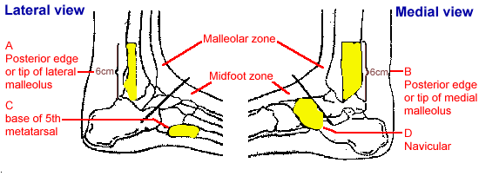
Ankle injuries
The best way is to perform physical examination
If there is point tenderness over a bony prominence then X-rays are warranted and you are probably dealing with a fracture.
Also pain medially require X-rays to rule out unstable sprains

Slide 29
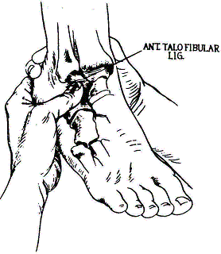
Ankle injuries
Ankle Sprains
Most common ligament injury is the Anterior Talofibular ligament (ATFL)
Palpation with pain along this ligament is diagnostic
Second most common is the calcaneneofibular ligament

Slide 30
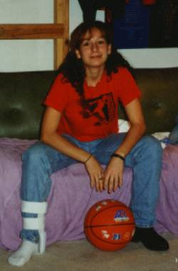
Ankle injuries
Treatment is RICE (Rest, ice, compression, elevation
This is followed by weight bearing as tolerated with a compressive wrap
Return to jogging when no swelling
Return to practice when no pain with cutting. May consider taping for practices

Slide 31
Sever’s Disease
Idiopathic condition caused by overuse injury of the calcaneal apophysis in a growing child that presents with posterior heel pain.
commonly seen in immature athletes participating in running & jumping sports
Treatment is usually activity modifications, stretching of the heel cord and NSAIDs as the condition typically resolves over time

Slide 32
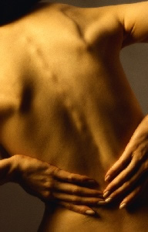
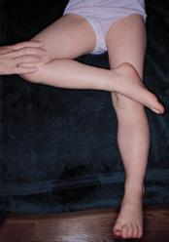
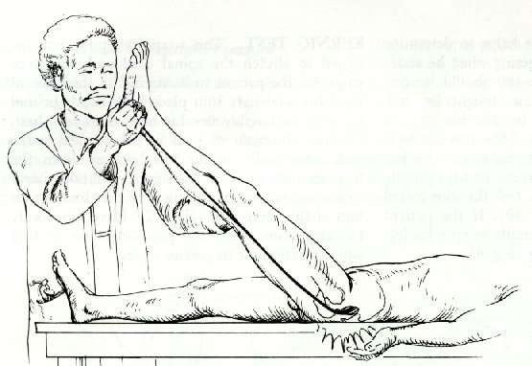
Low Back Pain in Athletes
Low back pain is very common
Pain for 3 weeks should be seen by MD
Physical examination
FABER test
Paraspinal spasm
Straight leg raise

Slide 33
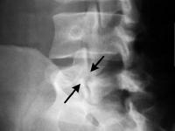
Low Back Pain in Athletes
Imaging
Start with plain film with obliques
Looking for Pars Intarticularis defect
Role of SPECT scanning is controversial unless diagnosis is in question (tumor?)
MRI for disc, edema, tumor, infection

Slide 34
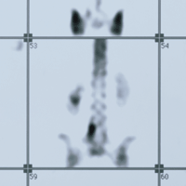
Low Back Pain in Athletes
Pars Interarticularis
Most common cause of back pain in adolescents
Can be an acute fracture (hot on SPECT) or chronic (cold on SPECT)
Some give braces for those with acute fractures
No difference in outcomes from true healing and fibrous union
SYMPTOMATIC TREATMENT

Slide 35
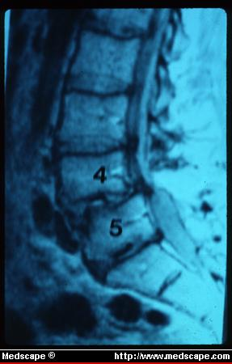
Low Back Pain in Athletes
Pars Interarticularis
Watch for spondylolisthesis (anterior slippage of vertebral body) esp in immature pt for progression
If fail a trial of symptomatic treatment (ie halting activity for 6 weeks, stretching, abd strengthening and NSAIDS) then consider OR
OR goal is to achieve fusion

Slide 36
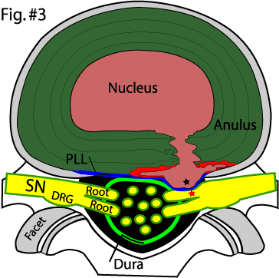
Low Back Pain in Athletes
Lumbar Disc Herniation
Rare in children
Radicular pain is common down leg.
Positive straight leg test
Can be a ring apophysis avulsion instead of disc
Conservative treatment is the norm
OR for recalcitrant pts

Slide 37
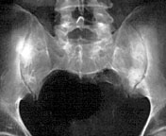
Low Back Pain in Athletes
SI joint pain
Pain with hyperextension
Positive FABER test
PT and NSAIDS cure most cases

Slide 38
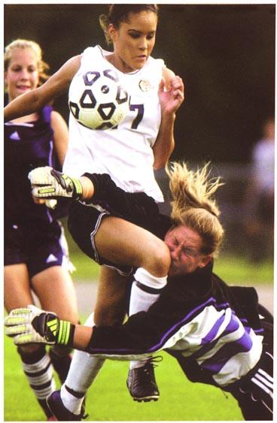
Catastrophic Sports Injuries
Head and Brain injuries
Intracranial hemorrhage
If there is a pressure phenomenon then decompression must occur with good outcomes.
Concussions
Watch for second impact syndrome (50% mortality rate)

Slide 39
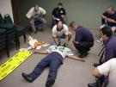
Catastrophic Sports Injuries
Cervical Spine injuries
Most seen in American Football
Is associated with bony column disruption
Key is the immobilization on the field without removing the helmet (have screwdriver ready).

Slide 40
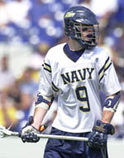
Catastrophic Sports Injuries
Sudden Death
Hypertrophic cardiomyopathy, aortic stenosis, aortic stenosis
Dysrhythmias
Cardiac contusion or commotio cordis

Slide 41
Miscellaneous Sport Issues
Heat Stroke
Incidence is on the rise, especially with the use of creatine
The cause is decreased sweating and evaporation in the face of rising temperatures
Dehydration adds to the cycle
Presents with hyperpyrexia, and mental status change
Treatment is immediate cooling, IV hydration, hospitalization
Key is prevention through early hydration

Slide 42
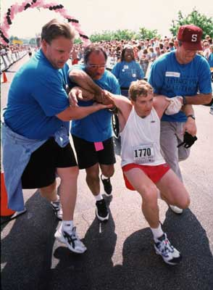
Miscellaneous Sport Issues
Overtraining syndrome
Described as chronic muscle pain with a decrease in performance
Common in endurance sports
VO2 max will be lower than their average
Treatment is rest (4-12 weeks) with plenty of sleep
Children should have at least 1-2 days off/wk and 1 week off every 2 months

Slide 43
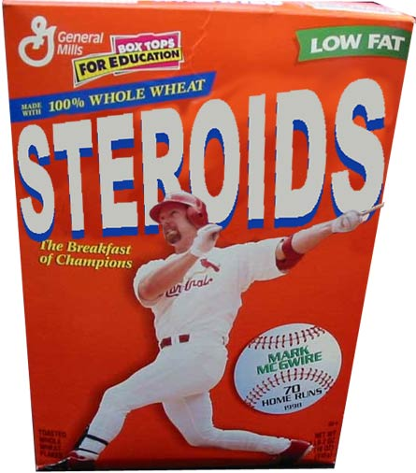
Miscellaneous Sport Issues
Steriods
Very common- 8% of high school athletes use anabolic steroids
Pressure from home/school fuels the need
Signs of increased acne, increased muscle, temperament changes, testicular atrophy
Downside: hepatic cancer, depression, suicide

Slide 44
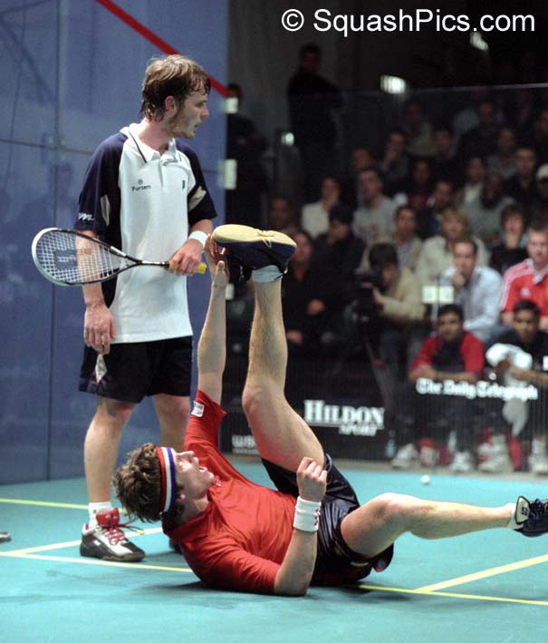
Miscellaneous Sport Issues
Creatine
Used as a nutritional supplement for increased body mass
Complaints include increased muscle cramps, inability to play
Long-term data is unknown

Slide 45
Thanks for Listening!

